Slide 1
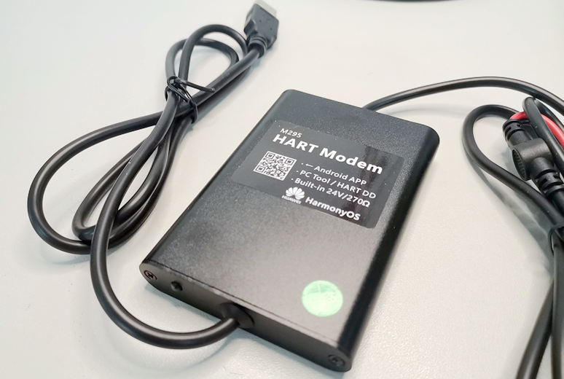
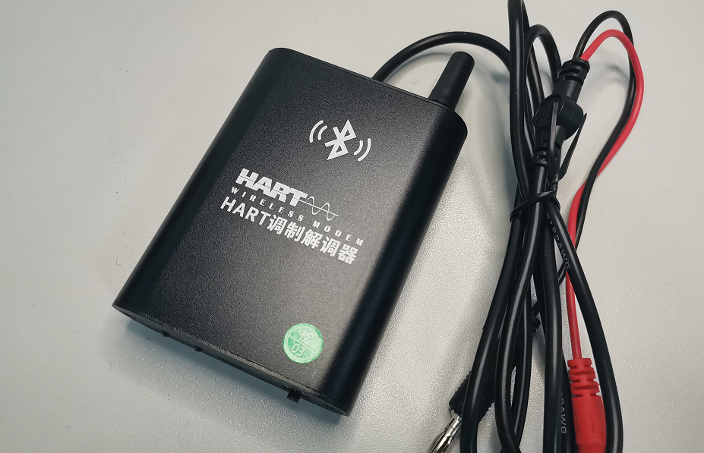
代替475 HART软件安装
M395 蓝牙HART调制解调器：
1）内置24V给仪表供电
2）内置270欧姆HART电阻
3）手机APP支持苹果、安卓、鸿蒙
4）EH艾默生PC软件全兼容
5）功能完全代替475/TREX
上海沃亚 M295 HART调制解调器
上海沃亚 M395 蓝牙 HART调制解调器
技术支持请联系
34239497@qq.com
周自伟 13681860506

Slide 2
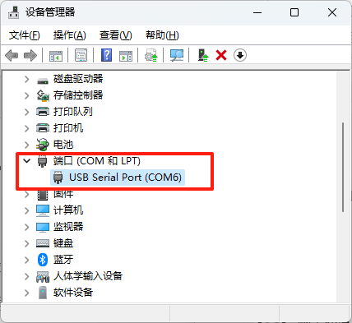
安装MODEM驱动
运行目录下的 modem_drivers.exe
M195/M295型号，将USB插入电脑
M395型号，用自带的USB充电线连电脑，将M395开机
查看设备管理器，会出来一个COMx口，如图
Run the modem_drivers.exe directory
M195/M295 model, plug the USB into the computer
For the M395 model, connect the M395 to the computer with the USB charging cable that comes with it
Check the device manager, and a COMx port will appear, as shown in the figure

Slide 3
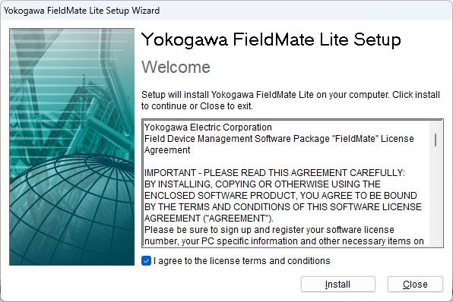
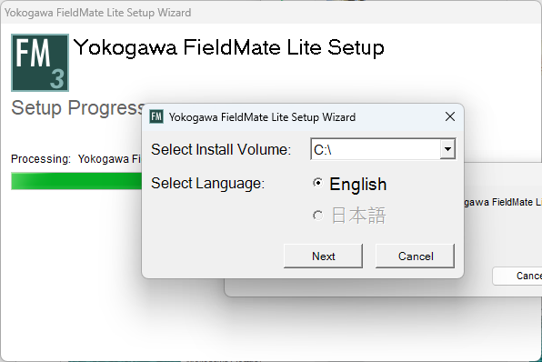
安装fieldmate
退出360等杀毒软件，否则安装会失败
解压缩目录下的 FieldMate.rar
运行setup.exe安装。默认安装路径为C盘，不要任何修改
安装完成，重启电脑
Quit antivirus software, otherwise the installation will fail
Unzip the FieldMate.rar in the directory
Run setup.exe install. The default installation path is C drive, do not modify it in any way
After the installation is complete, restart your computer

Slide 4
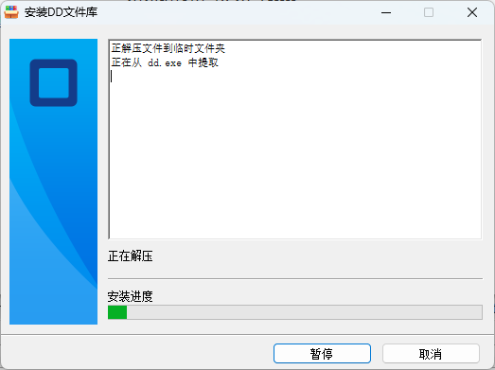
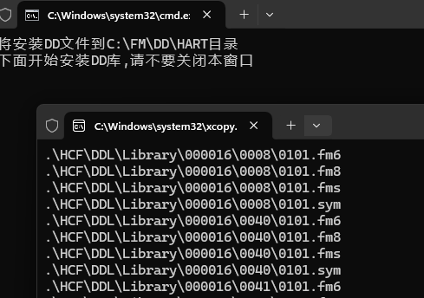
安装DD文件
HART仪表DD菜单文件已更新到2025年
双击运行dd.exe(密码为woyatech2020)，注意：不要自己做右键解压缩
看提示安装完
The HART DD file has been updated to 2025
Double-click Run dd.exe (password is woyatech2020), note: do not right-click to unzip by yourself
See the prompt to complete the installation

Slide 5

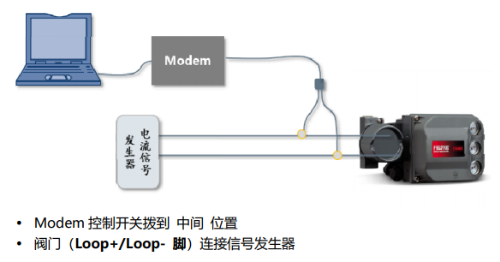
连接变送器
默认采用第一种方式连接变送器:
变送器和PLC/DCS断开 The transmitter and PLC/DCS are disconnected
MODEM开到24V/270Ω档位 MODEM is turned on to 24V/270Ω
MODEM连接变送器4-20mA输出端，点亮变送器屏幕 MODEM connects to the 4-20mA output of the transmitter and lights up the transmitter screen
连接阀门定位器，定位器需用信号发生器供电，MODEM开关拨到中间空挡 Connect the valve, the valve needs to be powered by a signal generator, and the MODEM switch is dialed to the middle neutral gear

Slide 6

运行Fieldmate
桌面上双击fieldmate图标
后页挑选了一些主要的画面供参考

Slide 7
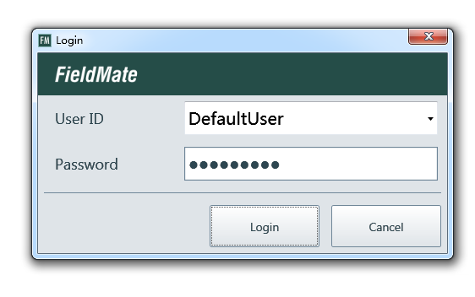
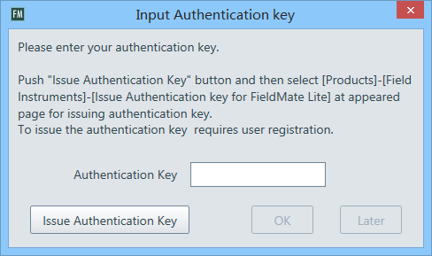
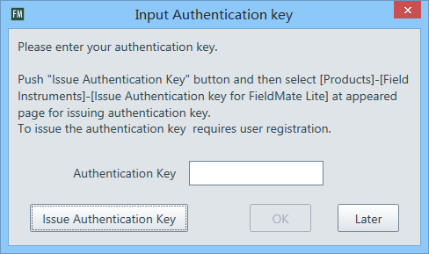

Slide 8
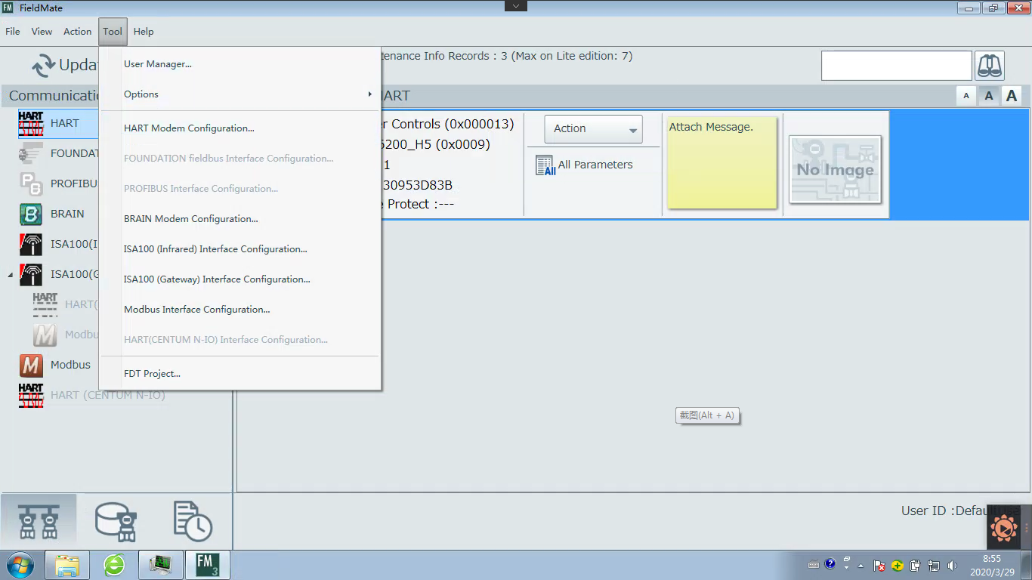
选择COM口

Slide 9
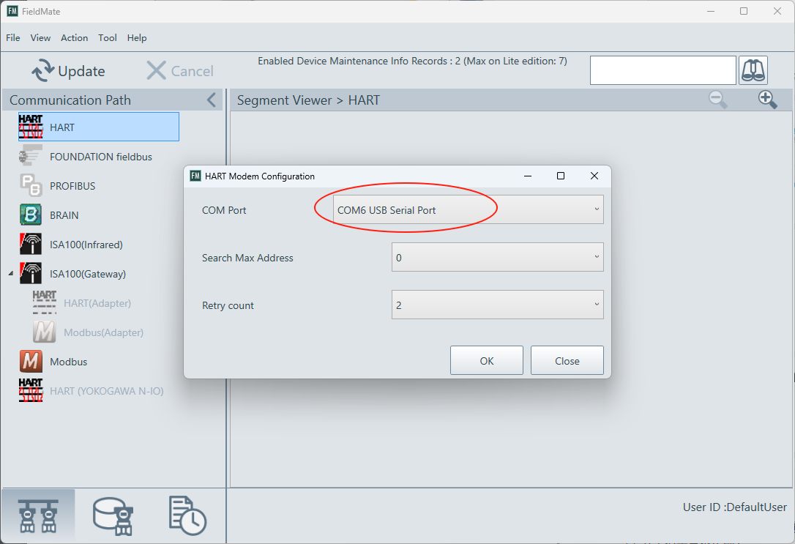
选择COM口

Slide 10
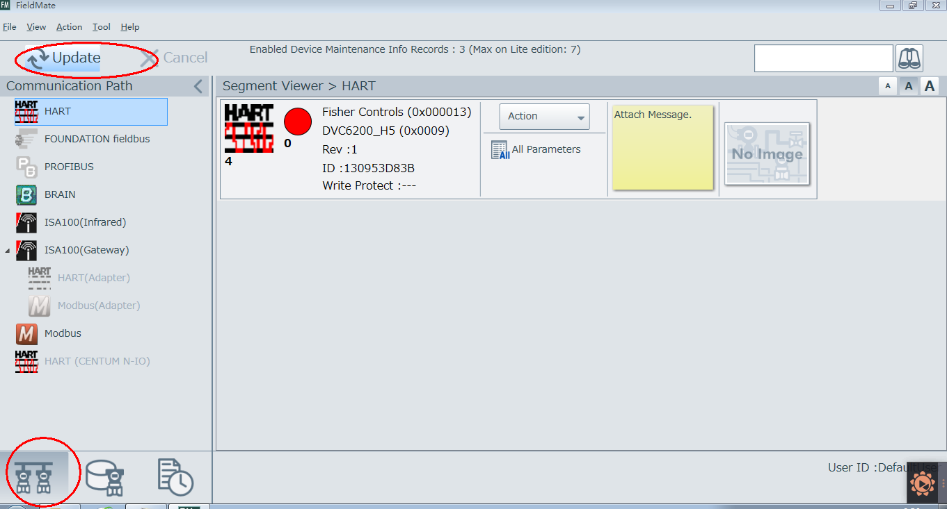
查找HART仪表
注意：要先选这个图标

Slide 11
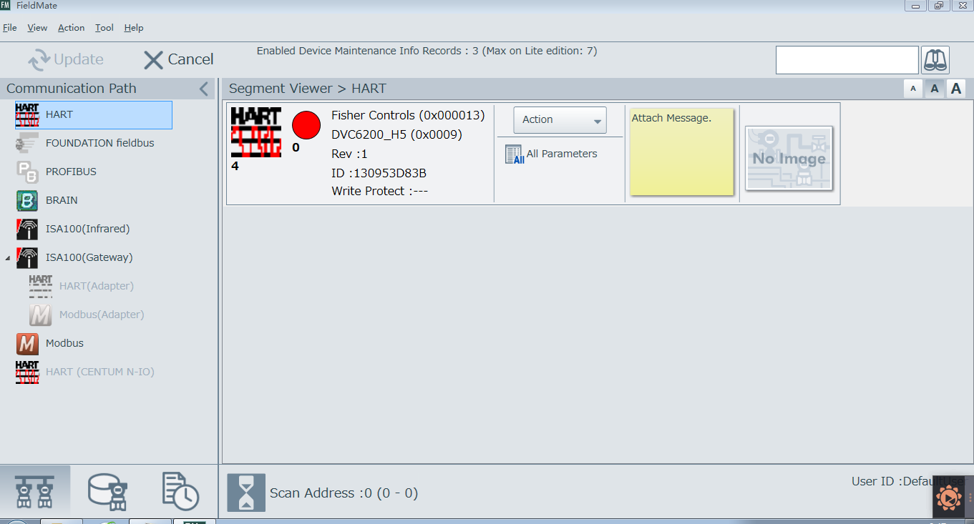
查找到一个仪表

Slide 12
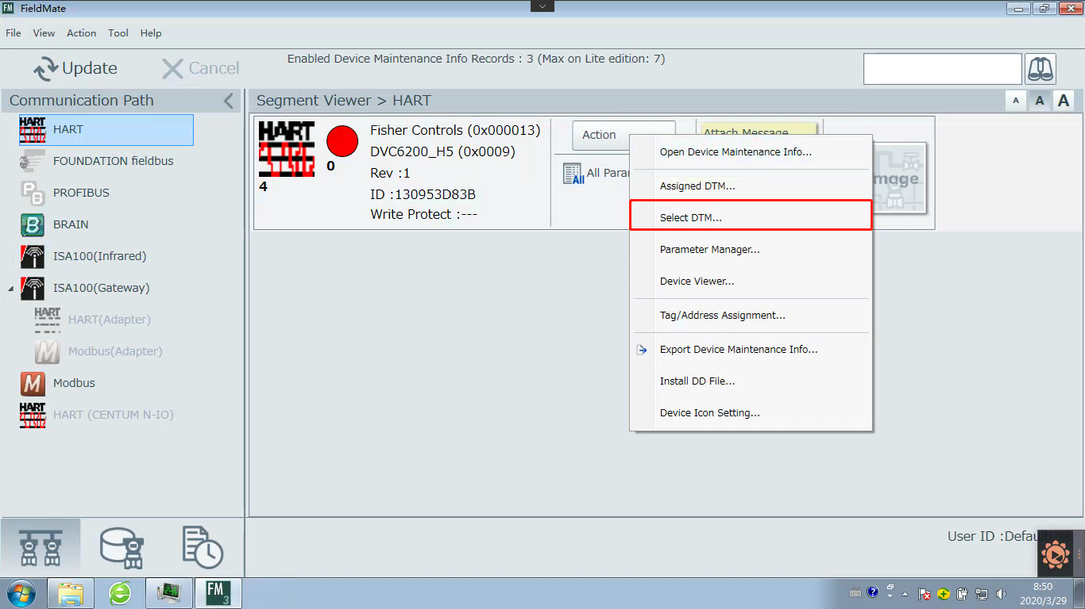
选择DTM文件

Slide 13
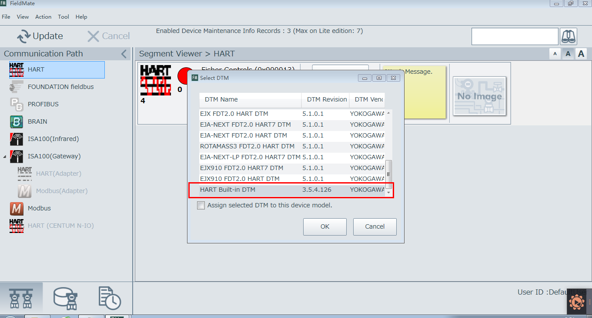
选择一个通用DTM

Slide 14
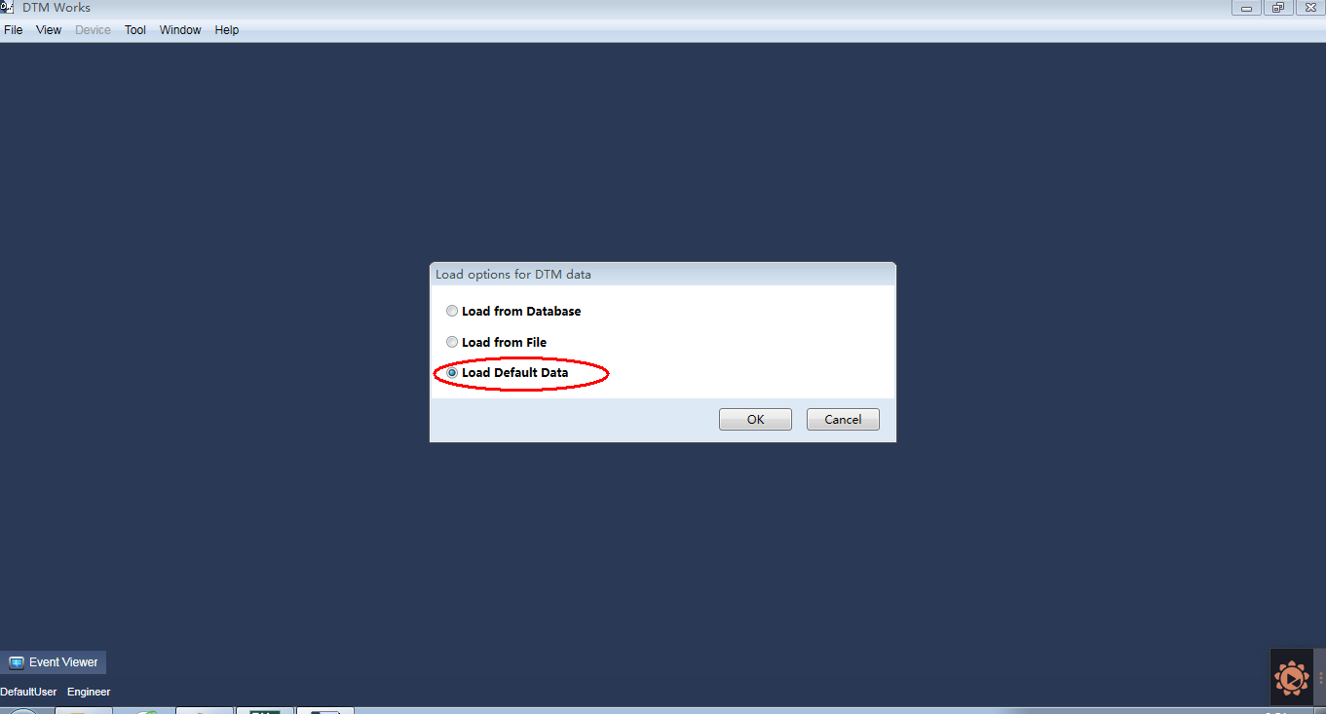

Slide 15
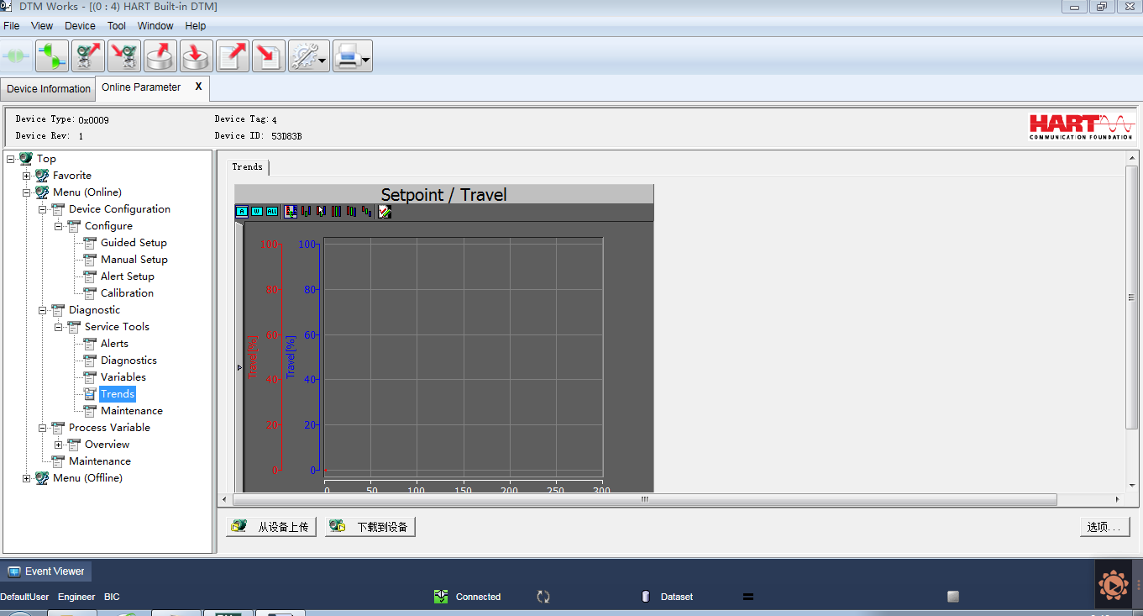
已进入online菜单

